Slide 1
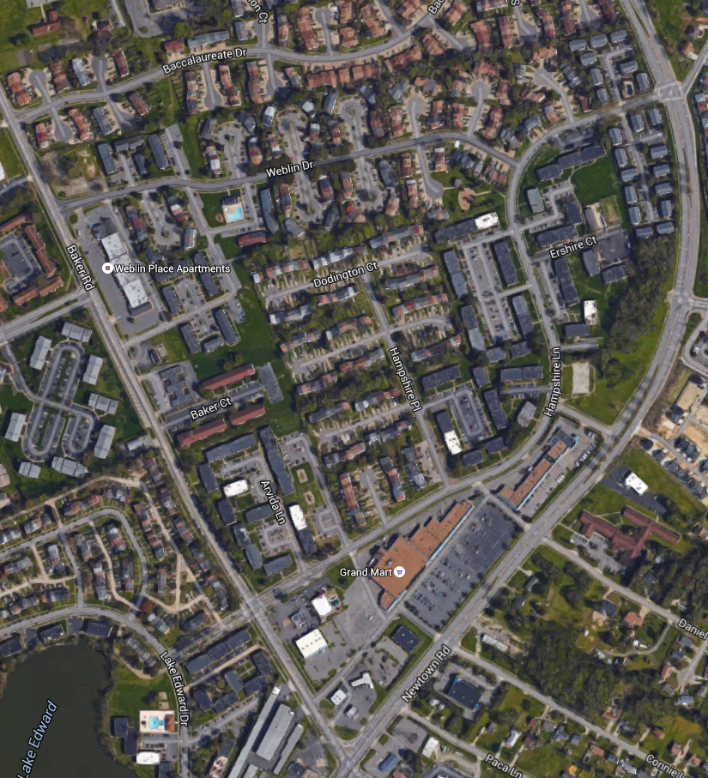
PROJECT MAP
Sewer Rehabilitation Project: Weblin Place
Please keep to the same format as provided, same font and sizing, same legend and directional.
This item MUST be returned in a fully editable version, including the map background used and all line markings.
Do not embed the map, street labels or pipeline markings.
Whenever possible use a Google map (Earth View) image
Map Content must include source attribution within the maps area.
You can find the attribution in the line(s) shown on the bottom of the Content in the products along with copyright notices, such as “Map data ©2015 Google”. Note that the exact text of the attribution changes based on geography and content type. The attribution text must be legible to the average viewer or reader.
Turn off street labels in Google and create your own (using the template/format provided) for the most prevalent streets and building.
Preferred color selections
All colors should be those that standout against the background
Weblin Drive
Baker Road
Weblin Place Apartments
Hampshire Lane
Newtown Baker Crossing
Newtown Road
LEGEND
Sewer Included in Project
The vision of HRSD is that future generations will inherit clean waterways and be able to keep them clean.

